Slide 1

PHARMAGUARD AI

Slide 2

The Problem
🚨 Pharmaceutical safety teams face two major challenges
1. Safety surveillance
  Thousands of adverse-event reports
  Difficult to identify important drug-event patterns
  Manual investigation takes time
  Emerging risks can be overlooked
2. Regulatory submission
  CTD dossiers contain hundreds of requirements
  Missing sections create submission risk
  Manual completeness checks are inefficient
  Regulatory teams need to prioritize what matters most
The real problem
Data exists. But turning that data into actionable intelligence is slow and fragmented.
What we asked
Can we build one intelligent platform that detects safety signals AND identifies regulatory gaps?

Slide 3
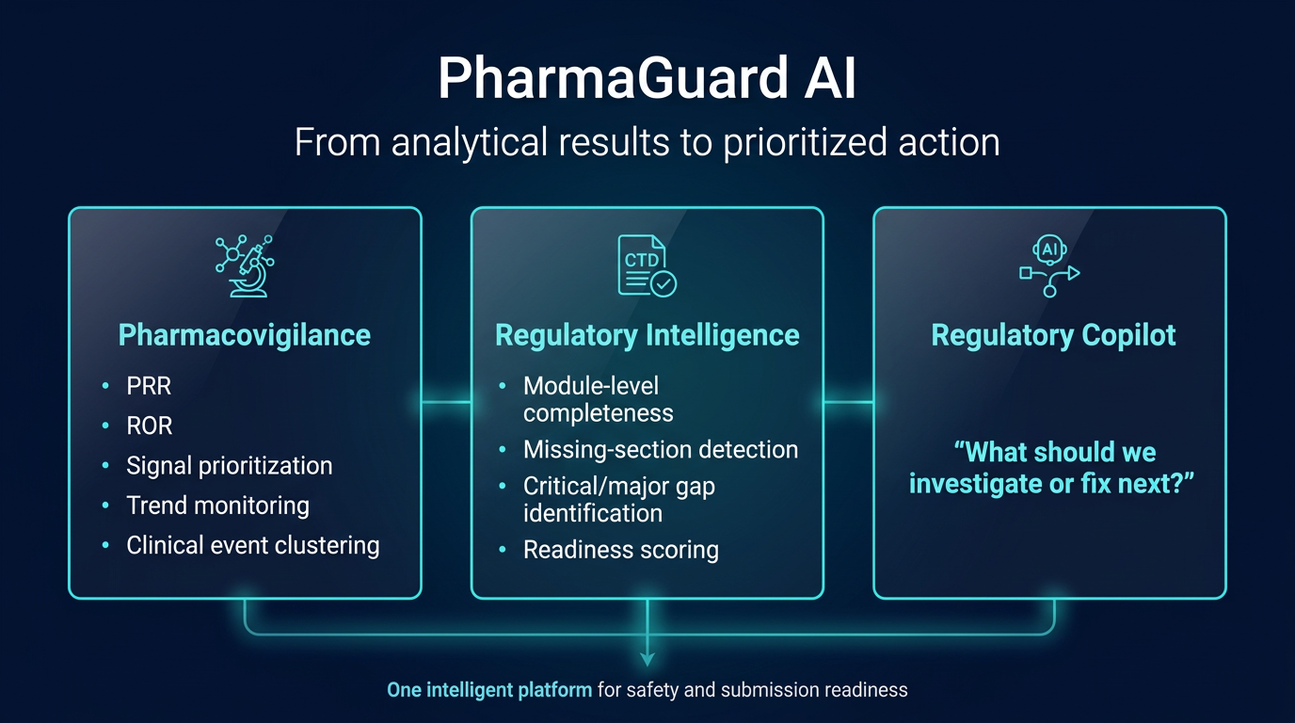
OUR SOLUTION
5

Slide 4
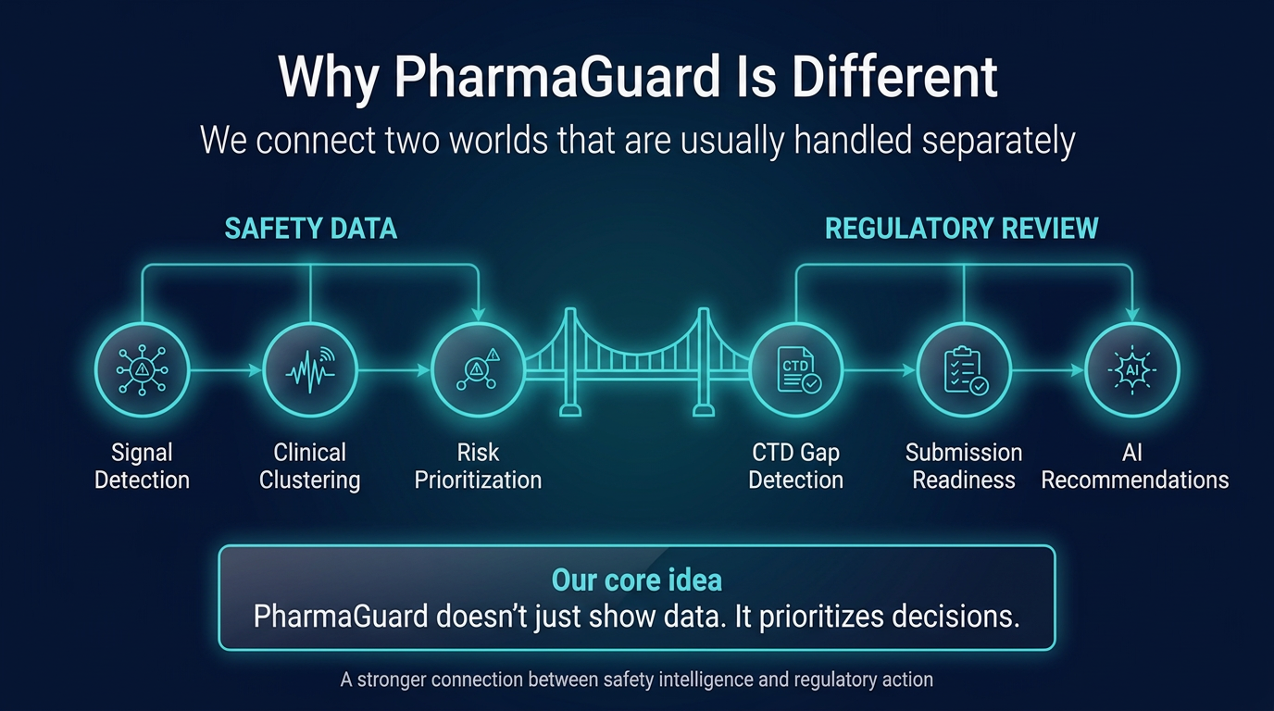

Slide 5
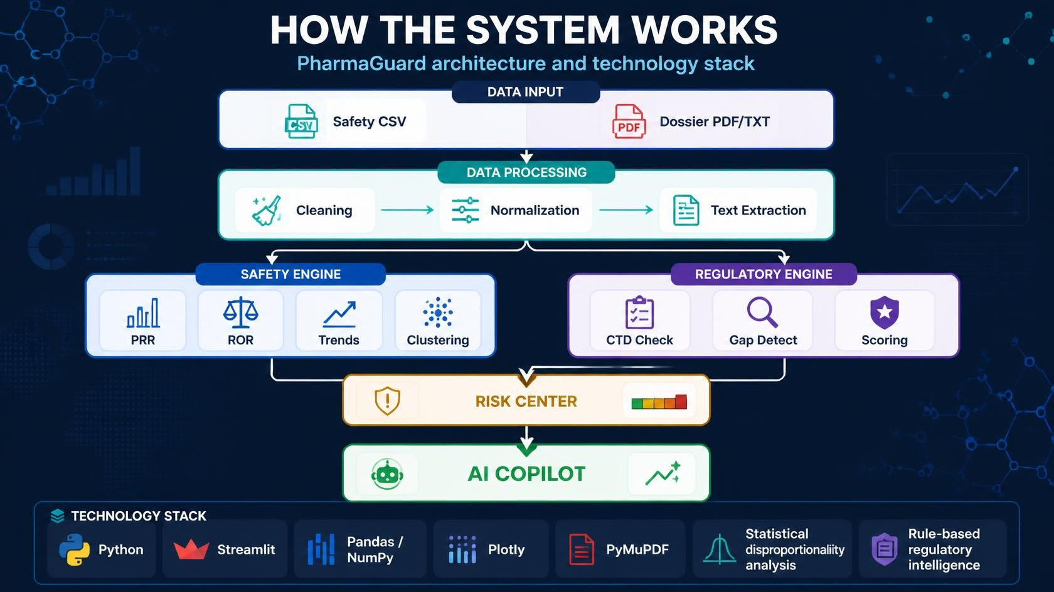

Slide 6
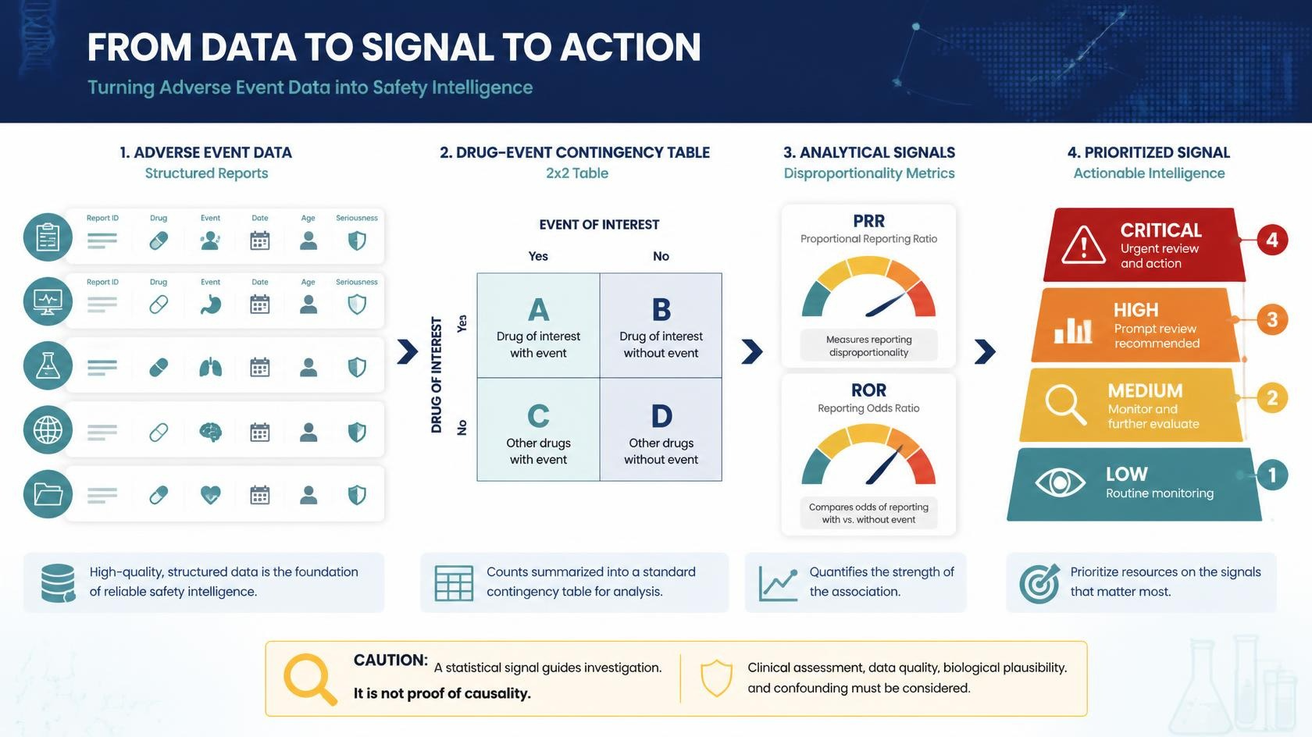

Slide 7
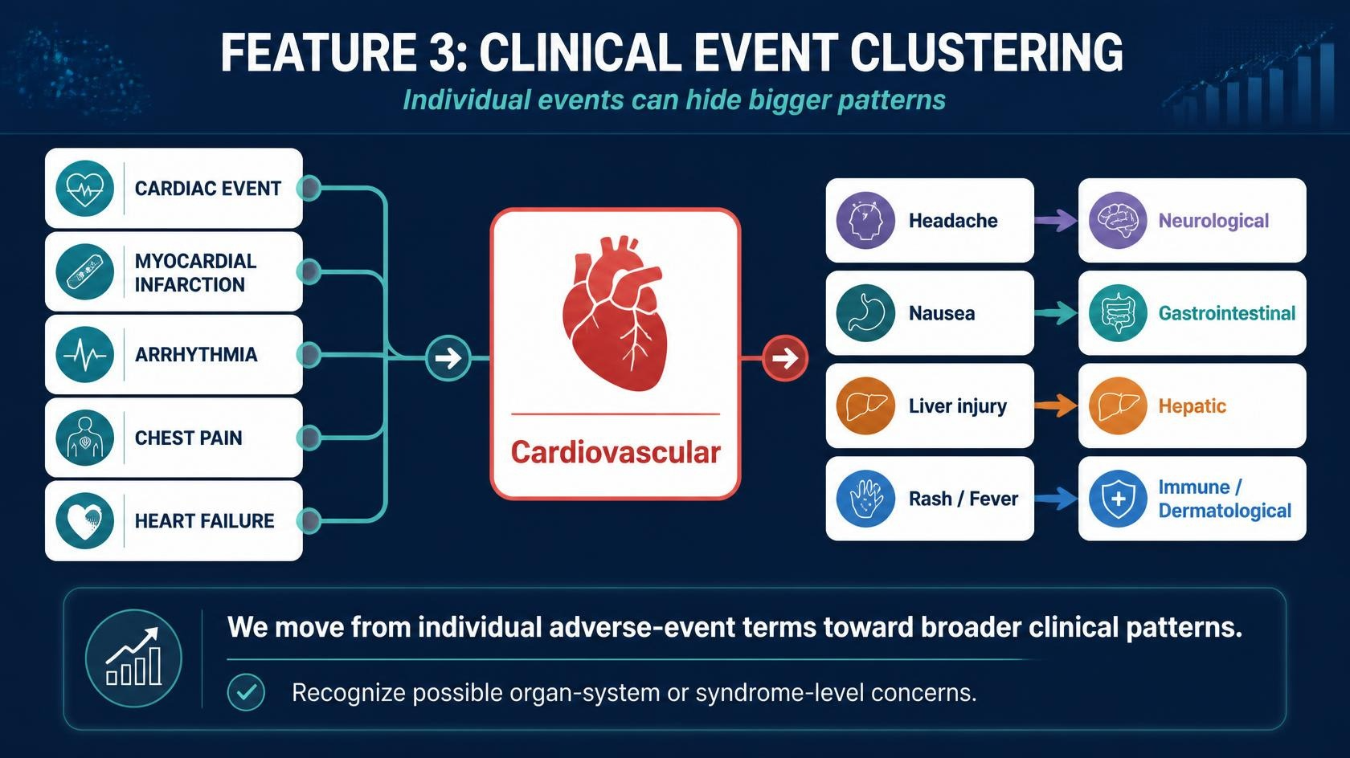

Slide 8
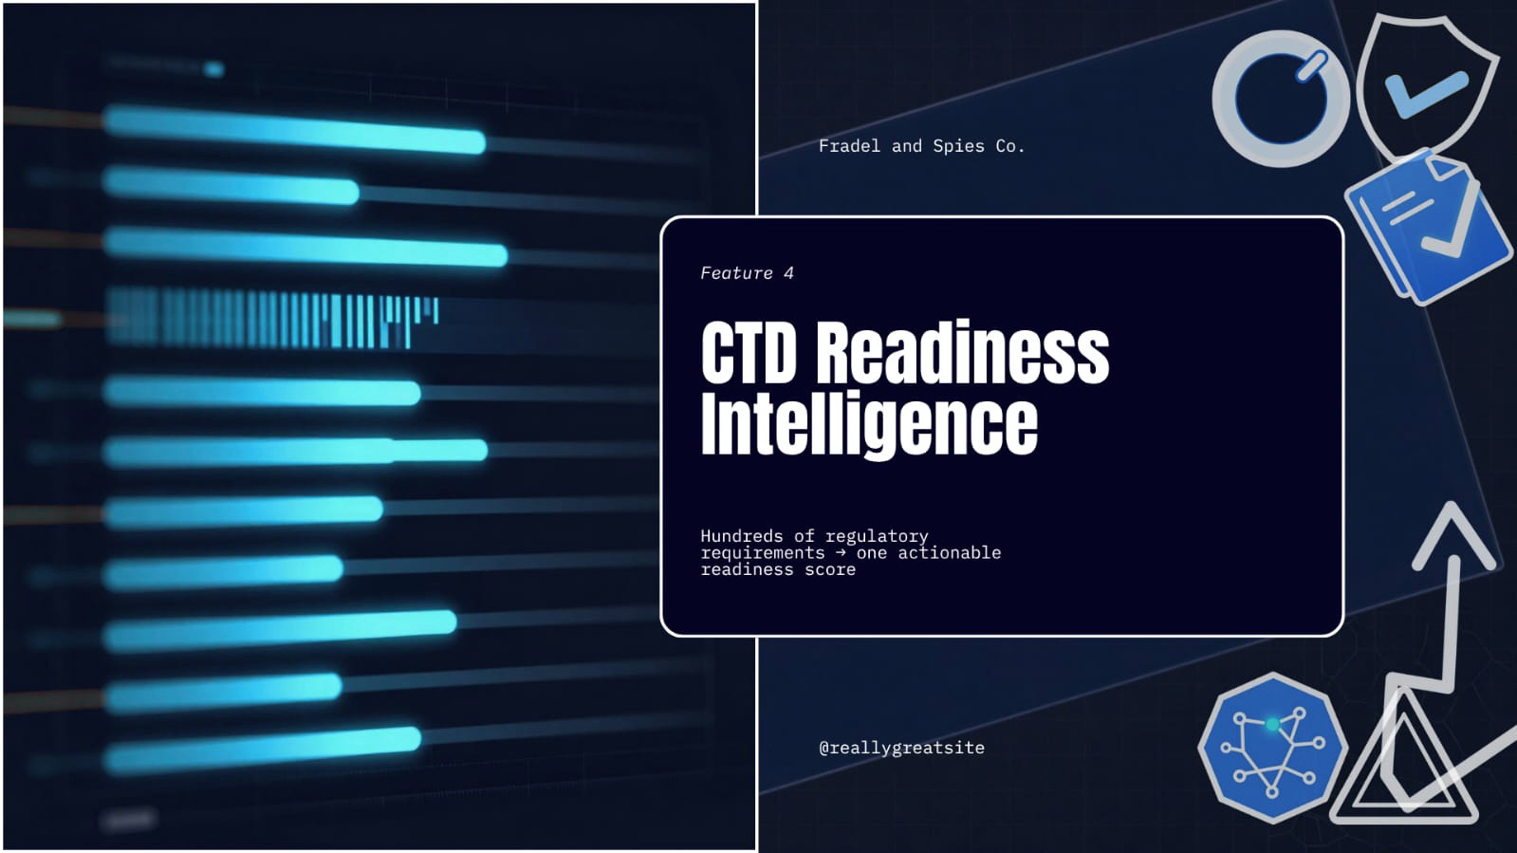

Slide 9

FEATURE 05
Regulatory Copilot
Turning analytics into action
PRIORITIZED RECOMMENDATIONS
ASK PHARMAGUARD
What to fix next
“What should we fix
01
Resolve critical gaps
ACTION →
before submission?”
02
Review major gaps
ACTION →
78%
03
Validate Module 2 summaries
ACTION →
Current CTD completeness
04
Verify Module 3 quality documentation
ACTION →
AI converts scattered gaps into a clear action plan.
05
Confirm Module 5 clinical evidence
ACTION →
THE PHILOSOPHY
AI should reduce cognitive workload — not replace regulatory experts.

Slide 10
LIVE DEMO
From signal detection to submission readiness
A 90-second journey through PharmaGuard
01
Executive
02
Safety
03
Signal
04
Event
05
CTD
Dashboard
Intelligence
Trends
Clustering
Readiness
PHARMAGUARD
Safety Intelligence
PV + REGULATORY
Target product
CARDIOLEX ▾
PRR
ROR
PRIORITY
⌂
Executive Dashboard
4.82
5.17
CRITICAL
◉
Safety Intelligence
Potential safety signals
Reporting trend
↗
Signal Trends
EVENT
PRR
ROR
PRIORITY
Cardiac arrhythmia
4.82
5.17
CRITICAL
NEXT
◌
Event Clustering
CTD
Hypotension
2.41
2.63
HIGH
▣
CTD Readiness
readiness
Dizziness
1.48
1.52
WATCH
RUN SUBMISSION READINESS ASSESSMENT →
Judge takeaway:
See the signal → understand the trend → prioritize the action → prepare the submission.

